Slide 1
Devangini Patel
Micro-expressions

Slide 2
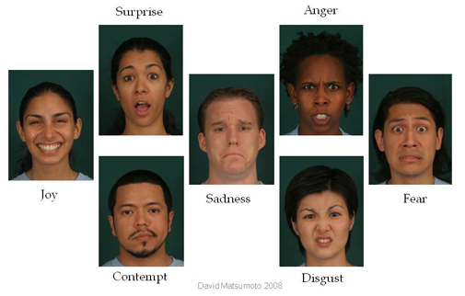
Facial expressions
Notes:
-A facial expression is one or more motions or positions of the muscles beneath the skin of the face. These movements convey the emotional state of an individual to observers. Facial expressions are a form of nonverbal communication. They are a primary means of conveying social information between humans, but they also occur in most other mammals and some other animal species
-Seven universal expressions have been identified. Expressions may differ a bit from culture to culture.

Slide 3
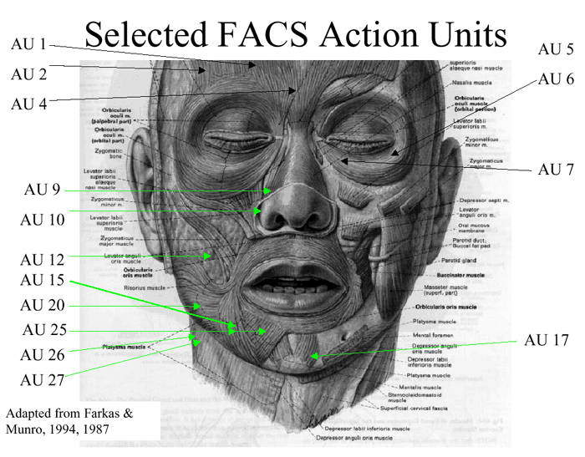
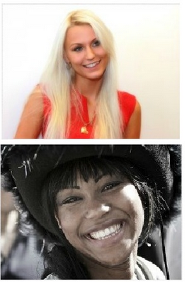
FACS

Slide 4
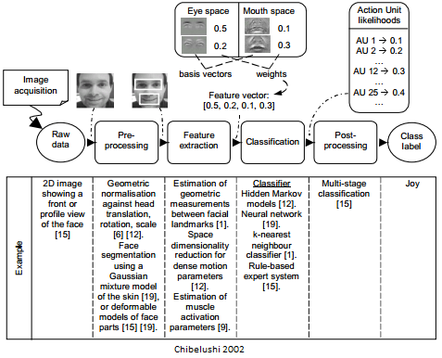
Facial Expression analysis

Slide 5
What is a micro-expression?
Micro-expressions are brief involuntary facial expressions shown on the face for a small lapse of time, generally 1/3 to 1/5 of a second.
They were discovered by Haggard and Isaacs and later coined by Paul Ekman when he was analysing the video of a suicide patient.
These are of two types: concealed micro-expressions when the person is trying to hide the true feelings and unconscious micro-expressions when the person is unaware of the emotion inside.
Humans can detect them with an accuracy of 47% and further improved by 10% with the help of training.
Software could prove to be more accurate and would help humans to understand lies, for better business negotiations, finding abnormal behaviour and hidden feelings.

Slide 6


What is a micro-expression?

Slide 7
Work done so far in microexpressions
Microexpressions
Databases:
Methods:
Posed
Spontaneous
SMIC
CASME
CASME II

Slide 8
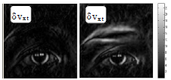
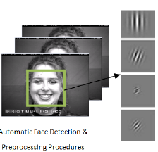
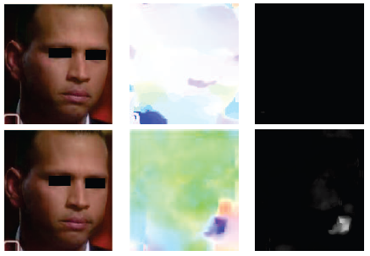
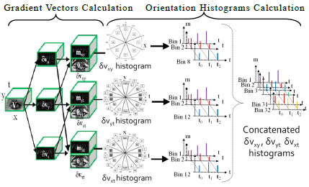
Posed microexpressions
Shreve et al. | Polikovsky et al. | Wu et al.
Notes:
Shreve et al. used strain patterns for spotting micro-expressions. Strain patterns consider the biomechanical properties of facial tissues and these are compared with theshold for spotting. Used rules (thresholding no. of regions and no. of frames)
Polikovsky et al. used gradient orientation histograms for micro-expression recognition. They detected the start, apex and end phase of the micro-expressions. K-means clustering for recognizing the region of activation.
Wu et al. used gabor filters and GentleSVM for spotting and recognizing micro-expressions.

Slide 9
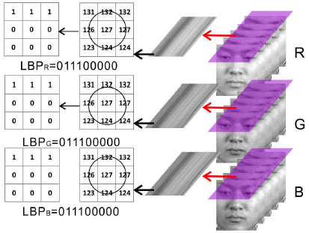
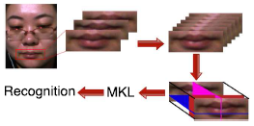
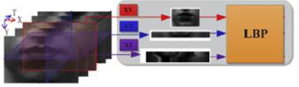
Spontaneous microexpressions
CMV | Wen-Jing Yan et al. | Su-Jing Wand et al.
Notes:
(i) Tomas Pfister et al. used temporal interpolation for increasing the frames, then spatiotemporal local texture descriptor and multiple kernel learning and random forest for recognizing micro-expressions.
(ii) Wen-Jing Yan et al. used LBP-TOP descriptors and SVM for recognition.
(iii) Su-Jing Wand et al. used LBP-TOP and Tensor Independent Color Space for improving the previous performance.

Slide 10
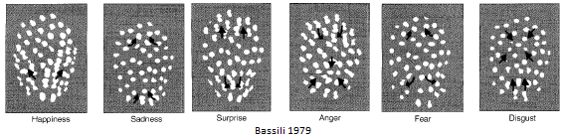
Exploiting motion

Slide 11
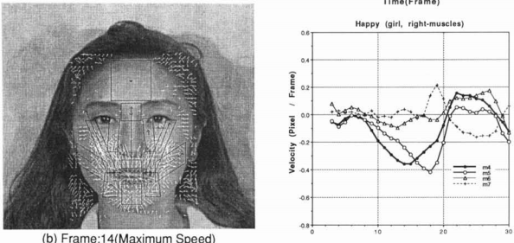
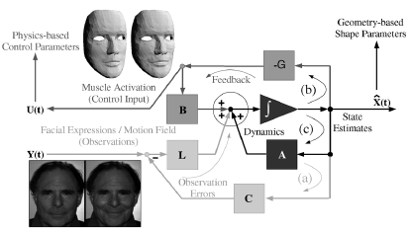
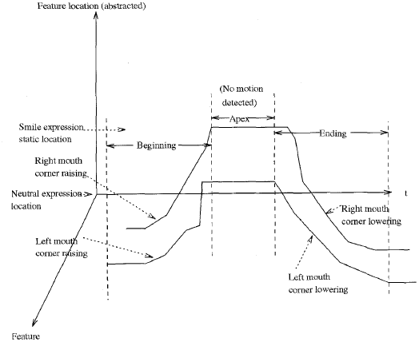
Exploiting motion
Kanji Mase 1990 Essa and Pentland 1997
Yacoob and Davis 1996

Slide 12
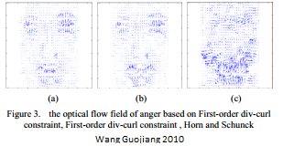
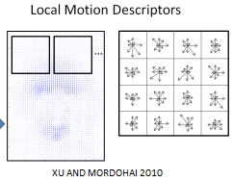
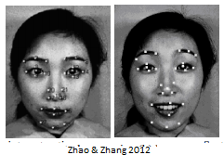
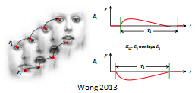
Exploiting motion
Spatio-temporal optical flow
Extended optical flow constraint
Tracking facial points
Motion words
Facial strain
Combining features
…

Slide 13
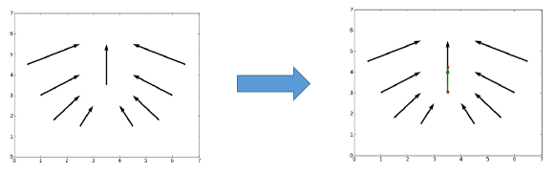
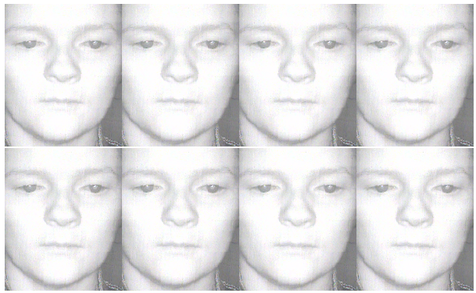
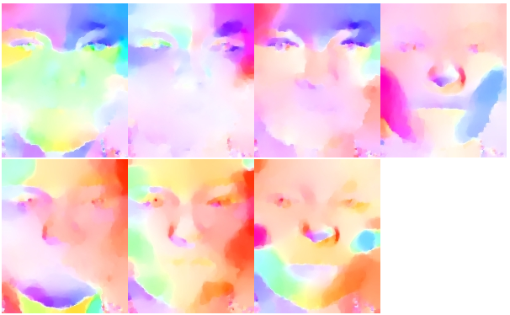
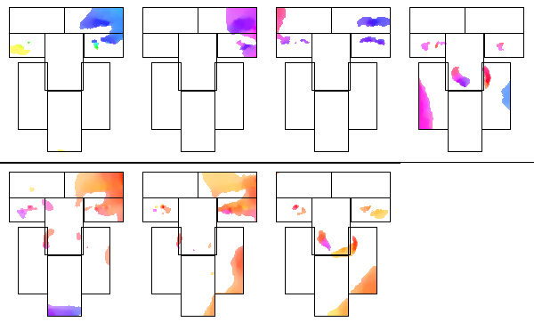
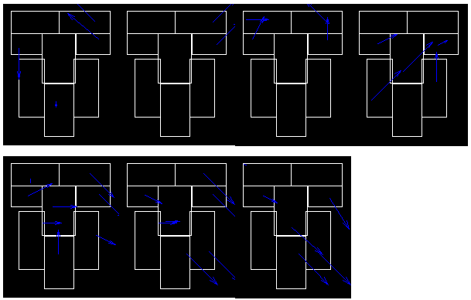
Some coding done on SMIC

